Slide 1


Slide 2

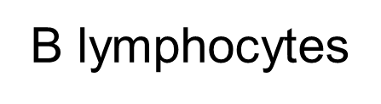
Capacity of the body to resist invading microorganisms that may cause damage
IMMUNITY
Innate
(Natural)
Acquired
(Adaptive)
Barriers
Cells
Humoral
Cellular
NK cells
T lymphocytes
Anatomical
Biochemical
Mechanica

Slide 3
Cellular immunity
Is the function of T lymphocytes
More important against :
viruses
cancerous cells
transplant organs…..

Slide 4
There are four types of T-lymphocytes:
1-Cytotoxic (killer) T cells :( CD8)
destroy the cells bearing foreign antigens
2- Helper T cells: (CD4)
help all the immune responses
3- Memory cells:
live in the body for long time
4- Suppressor T cells:
prevents over reaction of the cytotoxic T cells

Slide 5
Mechanism of action:
Usually, the invading organisms carry the antigenic materials.
These antigenic materials are released from invading organisms and are presented to the helper T cells by antigen-presenting cells.
„

Slide 6
Antigen-presenting cells are of three types:
1. Macrophages
2. Dendritic cells
3. B lymphocytes.
Among these cells, macrophages are the major antigen-presenting cells.

Slide 7
Mechanism of action:
T-cell come in contact with their target
Release PERFORIN molecules into target cells
PERFORIN molecules form pores in target cell membrane
Fluid and ions rush inside leading to lyses of cell
Also release digestive enzymes into their targets

Slide 8
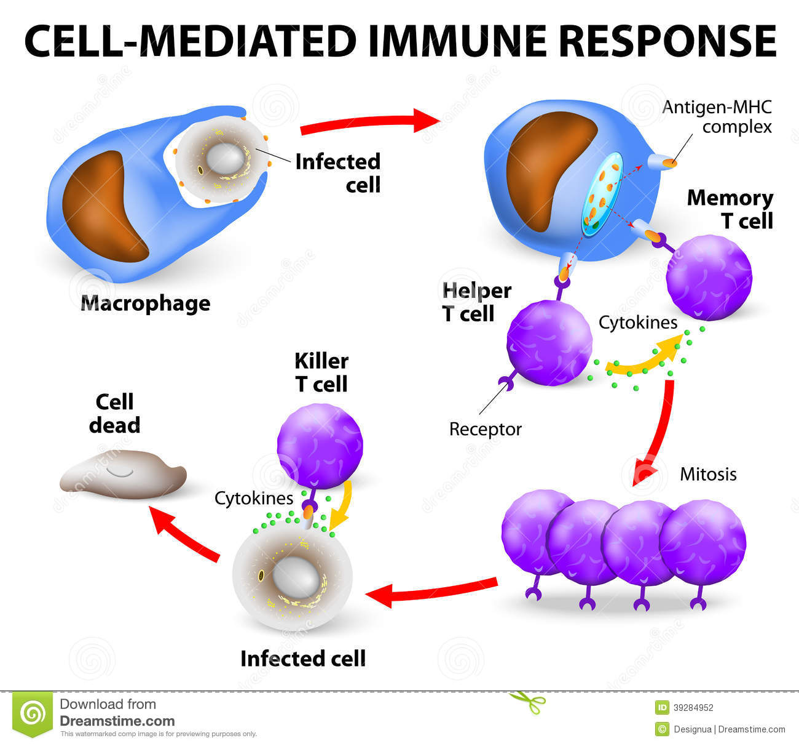


Slide 9
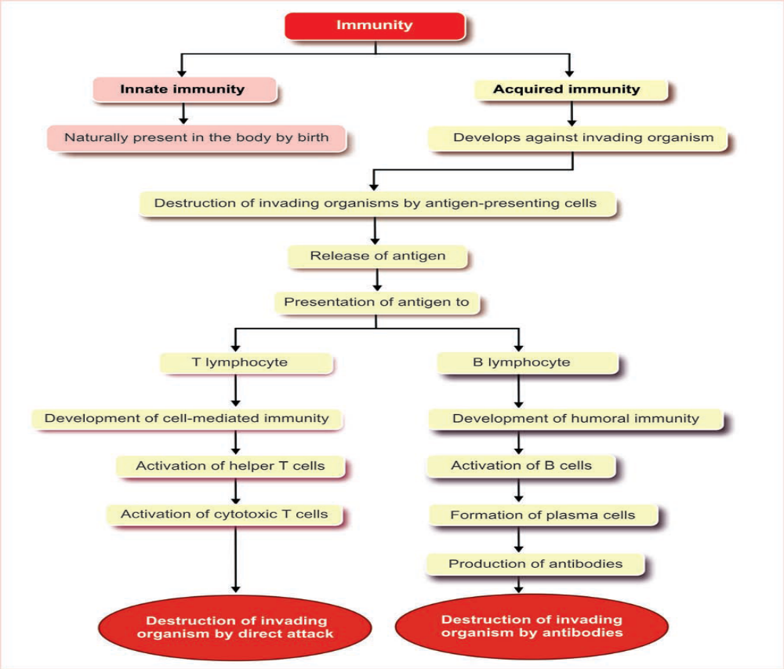

Slide 10
Immunization
Is the process by which the person is provided with immunity against a certain disease
Devided in to :
Passive immunity
Active immunity

Slide 11
Passive immunity:
Transfer of ready made antibodies or activated T lymphocytes formed by another person (or animal)
Transfer of antibodies from mother to fetus across placenta or in colostrum
It is short lived

Slide 12
Active immunity:
Production of antibodies as a result of exposure to an antigen, the immune system is activated
Can be :
-natural: exposure to the antigen from encountering the disease
-Artificial immunization : vaccination
It is long lasting

Slide 13
Vaccines
Vaccine is a substance that is introduced into the body to prevent the disease produced by certain pathogens.
Vaccine consists of dead pathogens or live but attenuated (artificially weakened) organisms.
The vaccine induces immunity against the pathogen, either by production of antibodies or by activation of T-lymphocytes.

Slide 14
IMMUNE DEFICIENCY DISEASES
Immune deficiency diseases are a group of diseases in which some components of immune system is missing or defective.

Slide 15
Acquired Immune Deficiency Syndrome (AIDS)
AIDS is an infectious disease caused by immune deficiency virus (HIV).
Infection occurs when HIV binds to surface receptors of T lymphocytes, monocytes, macrophages and dendritic cells leading to the destruction of these cells.

Slide 16
It causes slow progressive decrease in
immune function, resulting in opportunistic infections of various types.
The common opportunistic infections, which kill the AIDS patient are:
-pneumonia (Pneumocystis carinii)
- malignant skin cancer (Kaposi sarcoma).

Slide 17
The HIV infection spreads when secretions from the body of infected individual come in contact with blood of the recipient through the damaged skin or mucous membrane.

Slide 18
AUTOIMMUNE DISEASES
Autoimmune disease is defined as a condition in which the immune system mistakenly attacks body’s own cells and tissues

Slide 19



